Slide 1

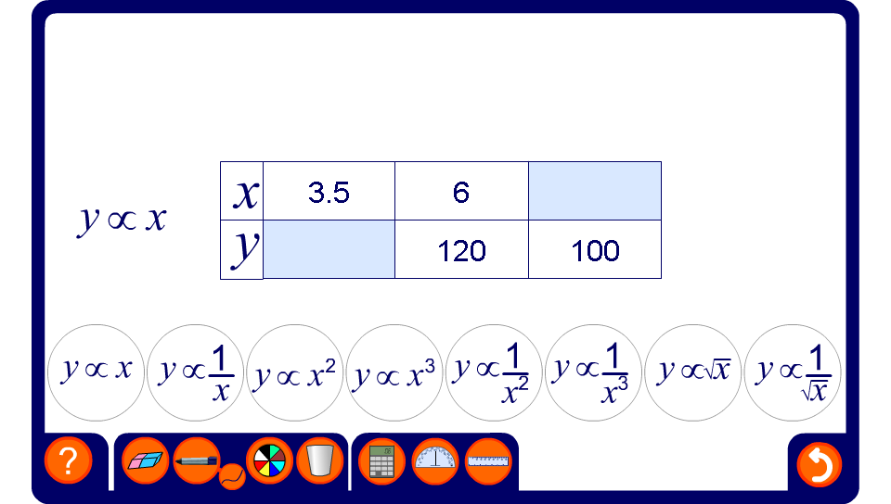


Complete the table of values
Notes:
Ask pupils to fill in the missing values in the table by finding the constant of proportionality for the given relationship or otherwise.

